Slide 1

Working with AI: Strengths, Shortcomings, and Role of Human Judgment
Session 2

Slide 2
Recap of Session 1
Definition & Scope: AI performs tasks requiring human intelligence (e.g., prediction, recognition). Generative AI specifically learns patterns to create new content (text, code, art).
The Learning Engine: AI relies entirely on massive datasets to learn. It uses algorithms to identify and replicate patterns, improving accuracy through repeated training.
The Critical Distinction: AI's intelligence is based on patterns, not comprehension. It does not truly understand context, emotion, or "why" a mapping exists.
Core Takeaway: Recognizing AI's reliance on patterns is essential for its confident, responsible, and effective use in any professional context.

Slide 3
Learning Objectives
Identify key strengths of AI, understand how they enhance workflows
Recognise limitations of AI and how they influence output
Establish the mindset and strategies to collaborate with AI using human oversight

Slide 4

Strengths of AI
To understand the abilities of AI that can help leverage ourselves

Slide 5

Speed and Efficiency
Unmatched Processing Speed: AI can scan, analyse, and process massive datasets (e.g., thousands of customer records or medical records) in seconds, not days or weeks.
Amplified Productivity: By handling repetitive and time-consuming tasks (e.g., data entry, summarizing forms), AI frees professionals to focus on work requiring creativity, empathy, and judgment.
24/7 Availability: AI tools like chatbots and virtual assistants operate continuously, ensuring instant responses and maintaining smooth operations outside of traditional working hours.

Slide 6

Analytical Power: Pattern Detection and Data Handling
Scale and Insight: AI thrives in situations with enormous data volumes where human analysis would be overwhelming.
Hidden Pattern Recognition: AI can detect subtle, non-obvious relationships in data that humans often miss (e.g., early warning signs in patient data, market shifts, financial fraud).
Consistency and Objectivity: When trained fairly, AI provides uniform and objective outputs, reducing the influence of human fatigue, mood, or personal bias in decision-making.

Slide 7
Strategic Impact: Augmentation, Not Replacement
Transforms Data into Insight: AI acts as a tool that converts raw data into clear, actionable information to support—not replace—professional judgment.
Augmentation of Human Capability: AI is most powerful as a collaborative partner, making human work more precise, data-informed, and creative (e.g., diagnostics assistance, personalized education, brainstorming).
Ubiquitous Utility: AI's strengths show up across nearly every domain, from simple tools like email filters and translation apps to complex predictive systems.

Slide 8

Limitations of AI
To understand the boundaries AI and establish realistic expectations

Slide 9
The Risk of Bias and Unfairness
Data Mirrors Society: AI learns from data, and if that data reflects existing real-world inequalities, stereotypes, or errors, the AI will reproduce and reinforce that bias.
Harmful Outcomes: Biased outputs can have serious consequences, particularly in high-stakes decisions (e.g., hiring, loan applications, and facial recognition accuracy).
Example: Historically, facial recognition systems have shown lower accuracy on darker skin tones due to underrepresentation in training data.
Key Takeaway: AI is not inherently malicious; it is a mirror of the data it consumes.

Slide 10
Accuracy, Reliability, and Data Dependency
The Hallucination Problem: AI can confidently produce information that is completely false or fabricated (hallucination) because it predicts what sounds correct, not what is factually correct.
Fluency ≠ Reliability: This reminds us that AI's fluency is not a guarantee of accuracy, making human verification essential in professional settings.
Data Limits: AI's performance is completely dependent on the quality and quantity of its training data. If the data is incomplete, outdated, or inaccurate, the output will reflect those flaws.
Fails at Novelty: AI often fails when faced with novel situations or inputs outside the scope of its training, where human intuition would adapt.

Slide 11
The Gap in Human Judgment
No Empathy or Morality: AI lacks feelings, values, ethics, and genuine comprehension of human emotion.
Simulation, Not Substance: While AI can simulate emotional tone (e.g., a sympathetic email), it does not genuinely care about the outcome or understand the moral weight of decisions.
Unsuitable for Compassion: This lack of empathy makes AI unsuitable for tasks that require compassion, moral judgment, or balancing fairness (e.g., sensitive management, counselling, complex ethical patient decisions).
Summary: AI is a powerful tool, but its limitations in bias, accuracy, and judgment confirm it cannot replace human oversight and ethical accountability.

Slide 12

Real World Example: Amazon Hiring
Scenario: in 2018, Amazon used AI to automate hiring based on historical successful applicant data.
The Problem: AI learned gender bias from historical hiring data (predominantly men).
The Outcome: System downgraded applications containing the word "women's" (e.g., "women’s chess club").
Takeaway: AI replicates bias from data; it is an assistant, not an authority.

Slide 13
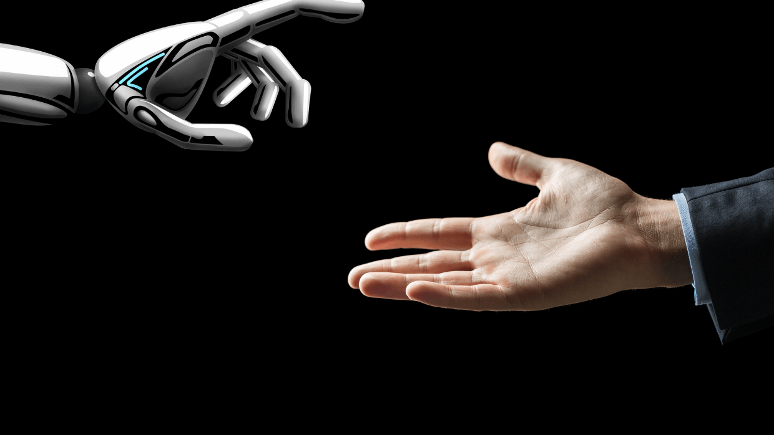
Human Oversight & Verification

Slide 14

Human Oversight
The New Focus: Move beyond AI's strengths and struggles to focus on responsible use and human oversight.
AI's Role Defined: AI is a powerful assistant, not an authority.
The Risk Factor: AI can produce valuable insights, but also mistakes, biased outputs, or fabrications.
The Key Skill: The essential professional skill today is critical thinking and discernment—not just using AI, but critically evaluating its results.

Slide 15

Practicing Discernment
Guiding Question:
Every use case should begin with, "Not 'Can I use AI here?' but 'Should I?' and 'To what extent should I trust it?'"
Examples of Discernment:
Healthcare: AI can summarize patient histories and schedule, but human judgment must diagnose and recommend treatment (AI lacks empathy and ethical reasoning).
Education: AI can generate lesson plans and quizzes, but it cannot replace a teacher’s understanding of a student's emotional or visual learning needs.

Slide 16
The Discernment Framework
Ask three guiding questions before relying on AI for a task:
What’s the Purpose? Am I using AI to save time, generate ideas, or make a judgment?
What’s the Risk? Is this low-stakes (like drafting an email) or high-stakes (like handling confidential information or health data)?
What’s the Verification Process? How will I confirm the output is accurate, appropriate, and safe to use?

Slide 17
Verification: Combatting AI Hallucination
Verification is the Next Responsibility: The process of double-checking AI’s outputs to ensure they’re correct and relevant.
The Rule of Thumb: Never assume AI is right just because it sounds confident (this is AI Hallucination).

Slide 18
Practical Verification Techniques:
Triangulation:
Check AI-generated information against multiple reliable sources (official reports, databases) or review the original document.
Reverse Prompting:
Ask the AI to explain or justify its answer (e.g., “What are your sources?” or “Can you show how you arrived at that conclusion?”).
Contextual Thinking:
Filter the response through your specific organisational culture and legal requirements, as AI cannot fully understand this context.
Peer Verification:
Use a “second pair of eyes” (colleagues) for review, especially for work going public or affecting others.

Slide 19
Accountability: The Human Mandate
Accountability Never Transfers: Even though AI may generate the content, humans remain responsible for the outcomes (document, analysis, or public statement).
Protecting Integrity: Taking ownership of AI-generated work and ensuring it meets our standards maintains professional trust.
Ethical Gatekeepers: Humans must act as the moral and contextual gatekeepers, ensuring AI's outputs reflect fairness, privacy, and cultural sensitivity.
The Ultimate Partnership: Human oversight is about building a partnership where:
AI handles the "what" (data, facts, efficiency).
Humans handle the "why" and the "should" (judgment, ethics).

Slide 20


Final Principle: AI should assist, not decide. Our role is to guide, question, and verify

Slide 21
Summary
AI Strengths (The 'What'):
Speed and Scale: Processes massive data volumes, analyzes reports, and generates content faster than any human.
Consistency: Works 24/7 without fatigue and finds hidden patterns in complex data.
Focus: Handles the heavy lifting (repetitive tasks) so professionals can focus on higher-value work.
AI Limitations (The 'Struggle'):
Lacks True Reasoning: Cannot understand context, emotion, or ethical reasoning.
Risk of Errors: Susceptible to data bias and hallucination (producing confident, false information).
Doesn't Know When It's Wrong.
The Human Mandate (The 'Should'):
AI Must Assist, Not Decide: Human oversight and verification are essential.
Practice Discernment: Know when to use AI and how much trust it deserves.
Core Principle: AI's real power is enhancing what we can do, guided by human judgment and integrity.

Slide 22

When AI gets it wrong: Case study activity
Please refer to the activity 2 instruction sheet

